Slide 1
IBM PROJECT
FERTILIZERS RECOMMENDATION SYSTEM FOR DISEASE PREDICTION
Team Members:
SRI SURAJ SR [TL]
SIVAKUMAR P
SRINESH R
SUNDARESWAR M
FACULTY MENTOR:
N.KANAGAVALLI
ASSISTANT PROFESSOR - CSE

Slide 2
ABSTRACT
Economy of India highly depends on agriculture. Still traditional ways of recommendations are used for agriculture. Currently, agriculture is done based on various approximations of fertilizers quantity and the type of crop to be grown or planted. Agriculture highly depends on the nature of soil and climate. Therefore, it becomes important to make advancement in this field. The paper proposes development of an ontology-based recommendation system for crop suitability and fertilizers recommendation. It bridges the gap between farmers and technology. The system predicts suitable crop for the field under consideration based on region in Maharashtra state of India and type of soil. It provides proper recommendation of fertilizers to the farmers. Fertilizer recommendation is done based on nitrogen, phosphorus, and potassium (NPK) contents of soil and using past years research data that is stored in ontology. Along with fertilizer recommendation system also provides suggestions about crop suitability in particular region. Recommendation system uses random forest algorithm and k-means clustering algorithm.

Slide 3
EXISTINGPROBLEM
In most of the existing methods, the process of finding the soil type, identifying the leaf disease and preferring the fertilizer were all carried out manually. The method was prone to various disadvantages. Even when the framework was digitalized, it has certain problems as, predicting a diverse fertilizer for a soil type, certain files regarding the leaf disease or soil type or fertilizer International In other situation the system may not provide the needed support. Hence in order to overcome some of these issues, the authors proposed a new approach.

Slide 4
PROPOSED SYSTEM
The proposed approach was organized in such a manner, that it is universal to all the users in the world. • The first step involves the registration phase, where the user has to present his personal details, details of land and the soil type. • In the second step the user will upload the soil test report into the system for soil analysis. In this step, if the soils test report was not submitted by the user, soil analysis will be carried out by the sensors. Sensors measure the nutrients level of the soil and the data was stored within the database. • In the third step, the corresponding crops infection status will be analyzed and recorded. • In the fourth step, comparison and classification of the soil type was carried out using Long or Short term Memory algorithm. Finally the fertilizers are recommended. The proposed approach was data centric and connected through the cloud. The main advantage of our proposed system is that, it was user friendly and highly efficient. The proposed system maintains privacy and also predicts accuracy.

Slide 5
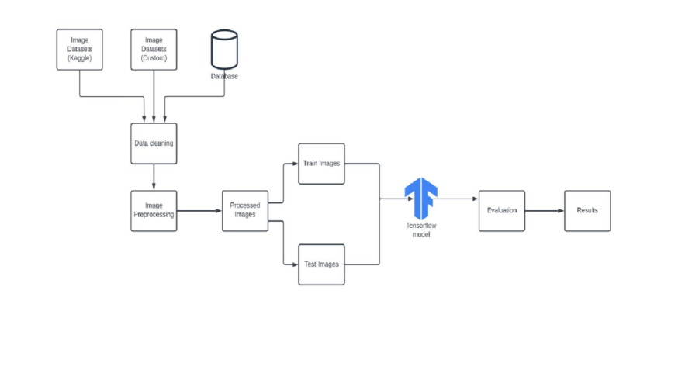
TECHNICAL ARCHITECTURE

Slide 6
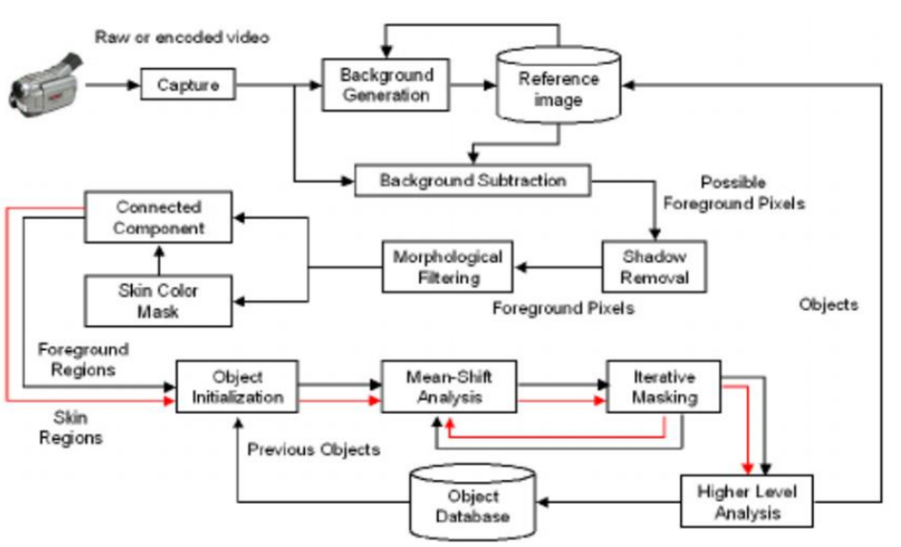
FLOW CHART

Slide 7
HARDWARE & SOFTWARE REQUIREMENT
To complete this project, you should have the following software and packages.
Software’s:
➢ Anaconda Navigator
➢ Visual studio code
➢ Jupiter notebook
➢ IBM Watson studio
Packages:
➢ Tensor flow
➢ Keras
➢ Flask
➢ numpy
Pandas

Slide 8
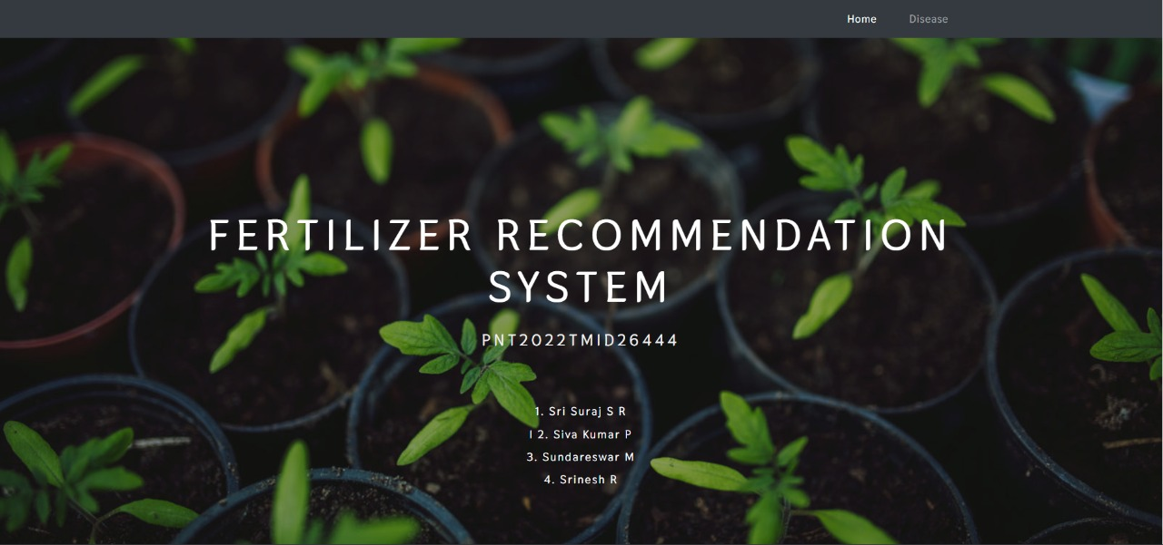
OUTPUT

Slide 9
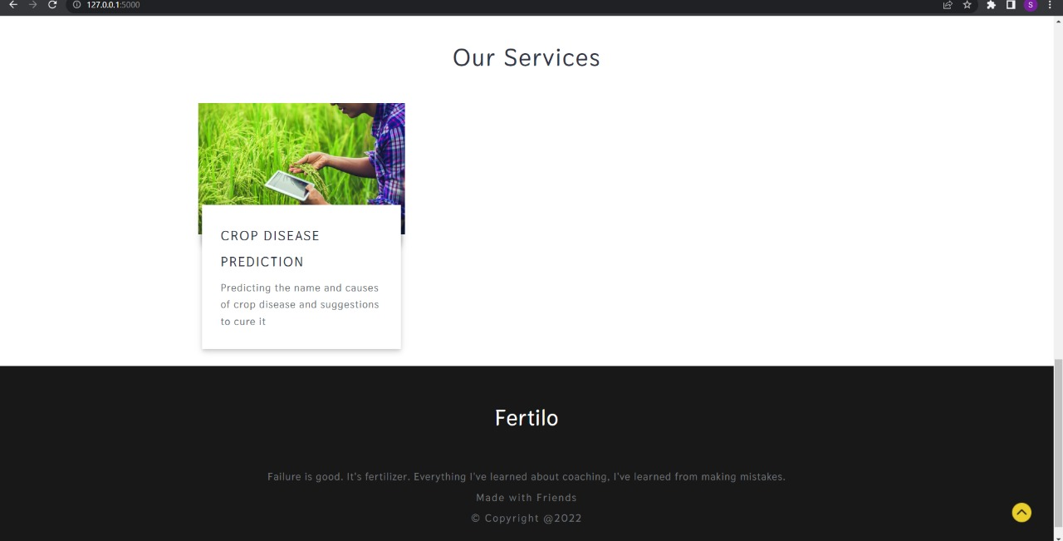

Slide 10
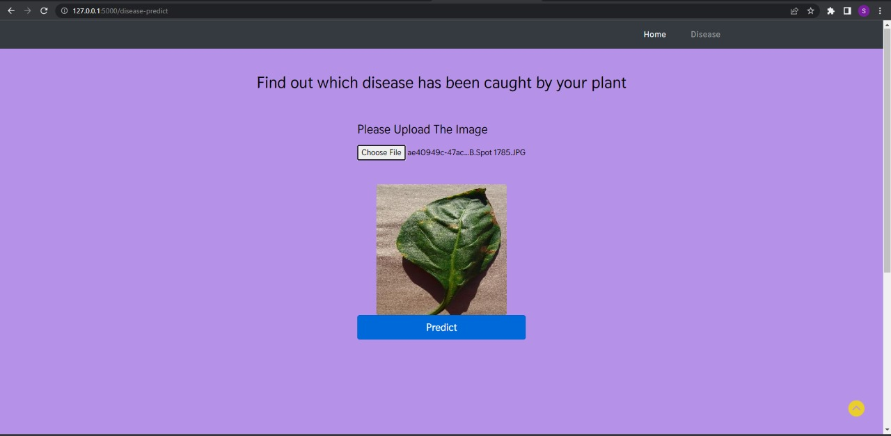

Slide 11
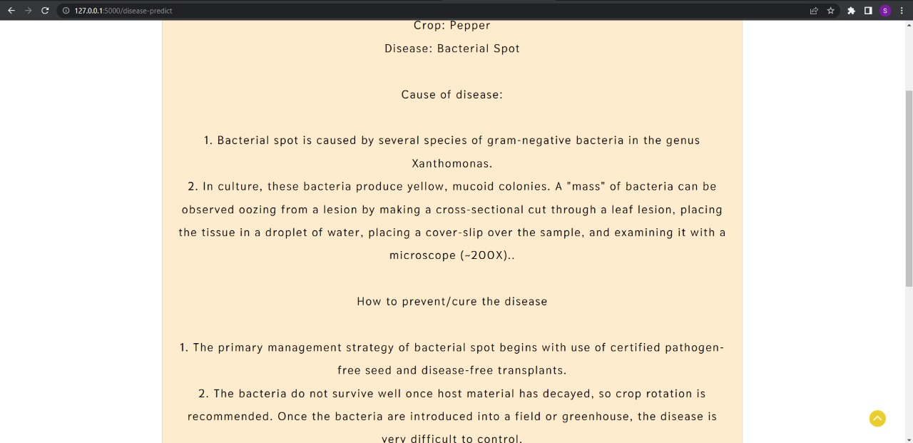

Slide 12
APPLICATION
This website can be used by farmers and customers to check whether their plant is infected and to view the treatment so they can take the necessary precautions
These web apps can be used for small indoor plants as well as in the agricultural sector.

Slide 13
Thank you
Team Members:
SRI SURAJ SR [TL]
SIVAKUMAR P
SRINESH R
SUNDARESWAR M

